Slide 1

Stack Overflow 2018 Developer Survey Analysis
Group Members
MaryLu Granja
Pooja Sheelvanth
Peter Park

Slide 2
Questions of Interest & Hypothesis
Being a part of the this community drove our curiosity to identify its makeup
Hypothesis: Young males make up the vast majority of the developer industry and earn more than other genders.
Questions asked:
What is their educational background?
Do they make earn more?
Are they more satisfied in their career choice?

Slide 3
What is Stack Overflow?
Stack Overflow is a site where students and professionals post questions and responses about programming.
Created in 2008 by Jeff Atwood and Joel Spolsky
Addresses a wide range of topics in computer programming
It’s also a platform that developers use to look for jobs
Data obtained from their in-house developer survey
Used Stack Overflow 2018 Developers Survey to analyze our hypothesis

Slide 4
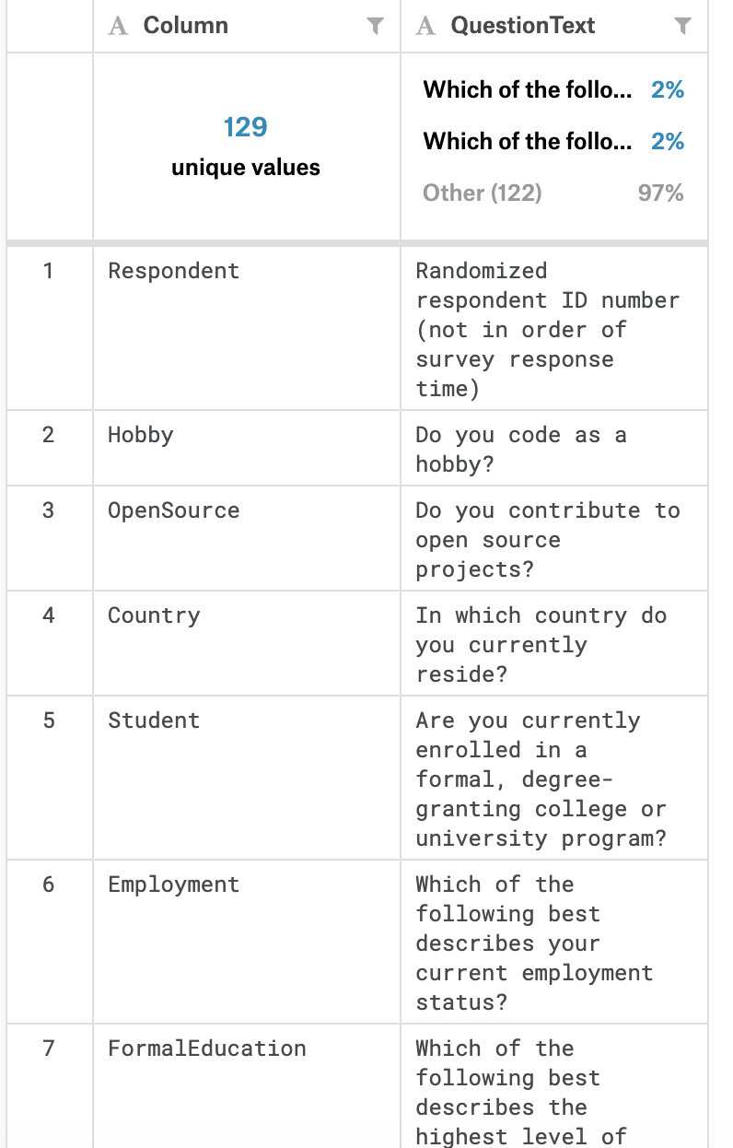
Survey Schema
Over 100,000 developers responded to the 30-minute survey in January 2018.
129 unique columns including 128 questions ranging from educational background to career and demographic questions

Slide 5
Data Exploration & Cleanup
We split the .csv file into several individual data frames such as Gender, Age, Education , Career Satisfaction, Salary, etc.
Multiple questions had select all that apply
Various methods were used to properly quantify the results
Some responses were shortened to properly fit in the visualizations
Converted Likert values and categorical responses into integers
Removed nulls and Nas
Survey results were too large to upload. Git LFS was used to Upload to GitHub

Slide 6
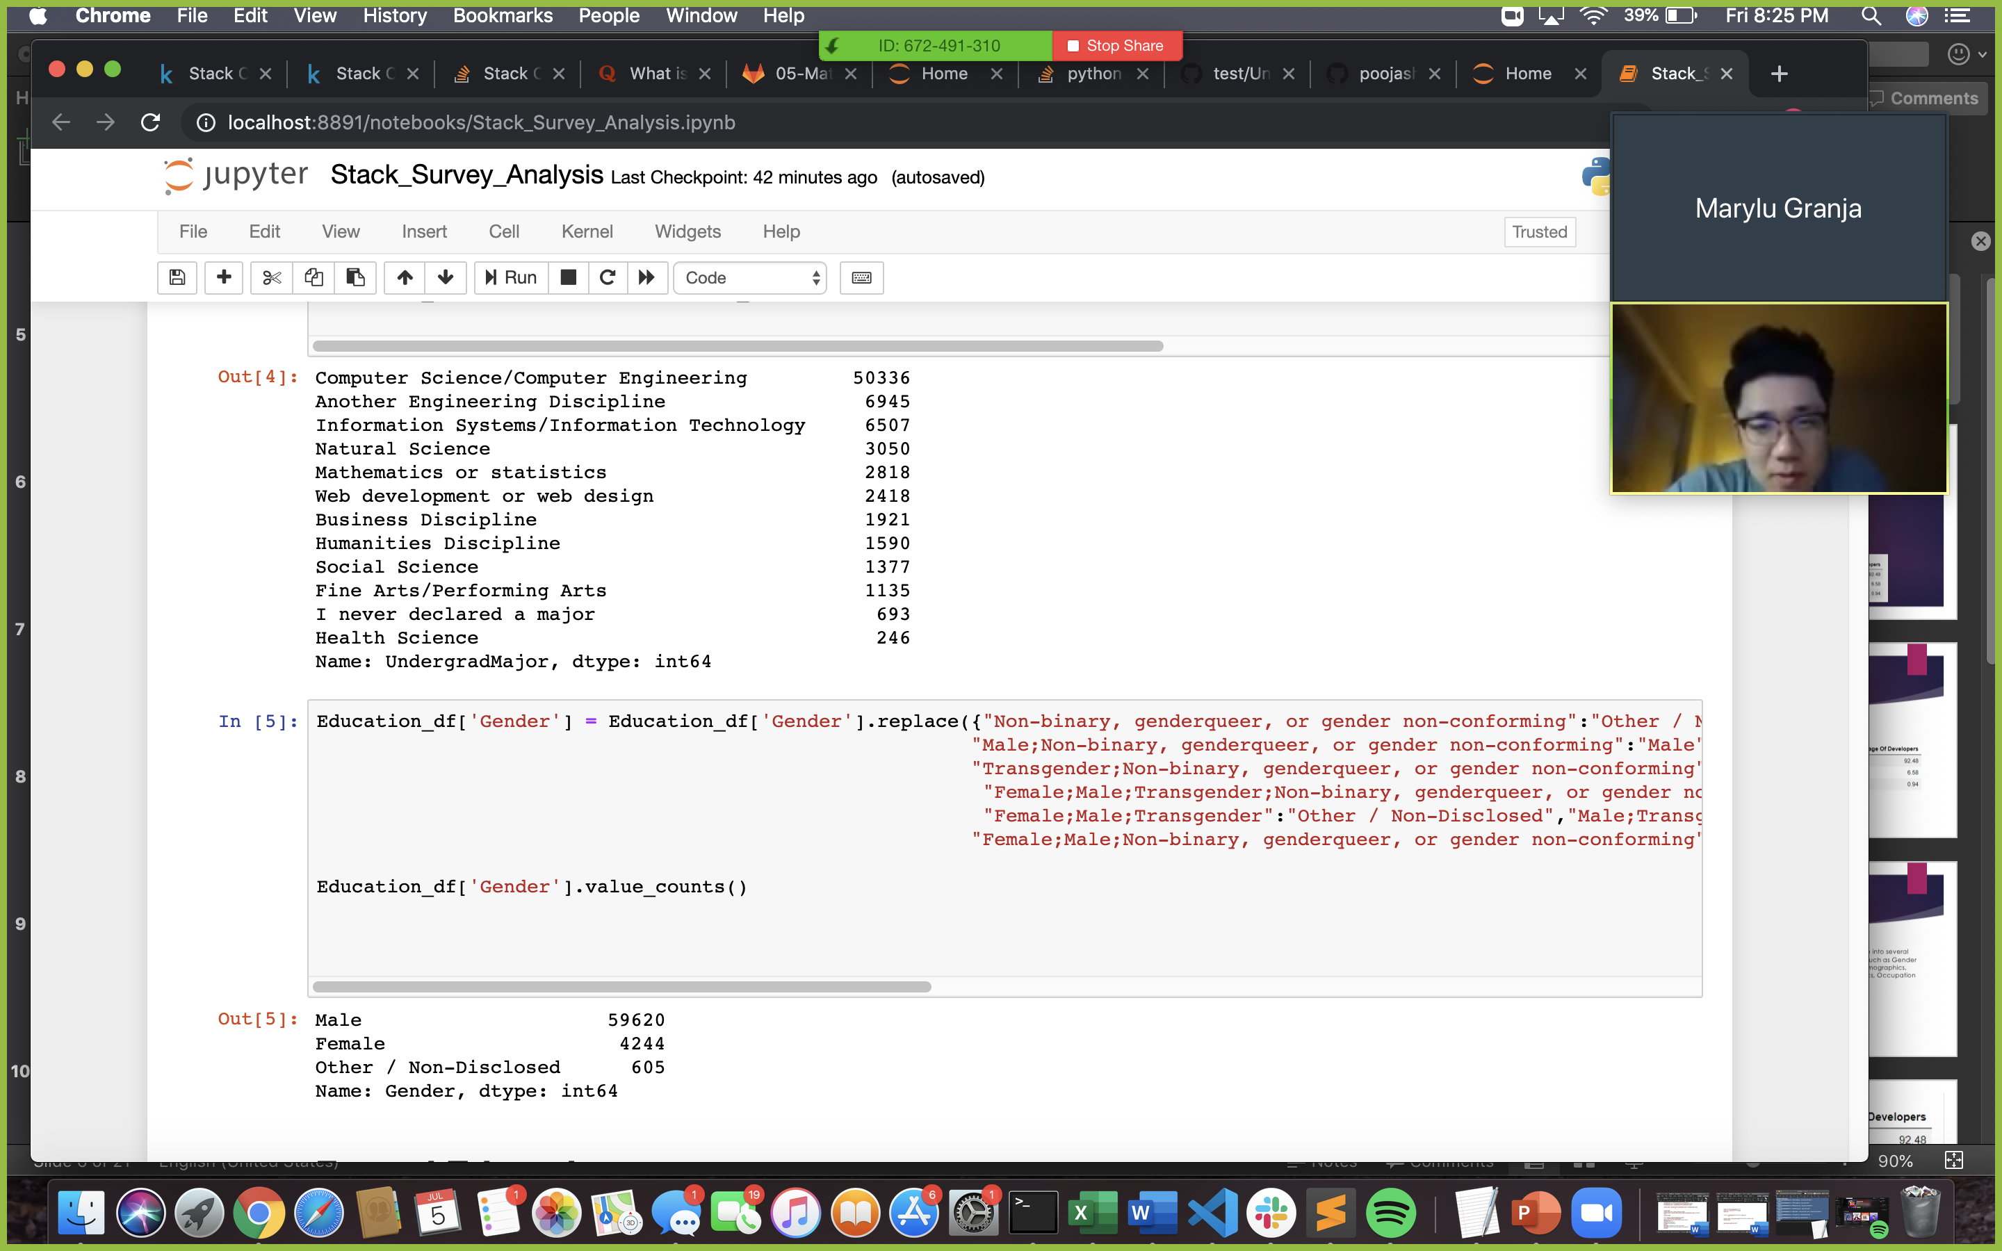
Data Exploration & Cleanup Examples

Slide 7
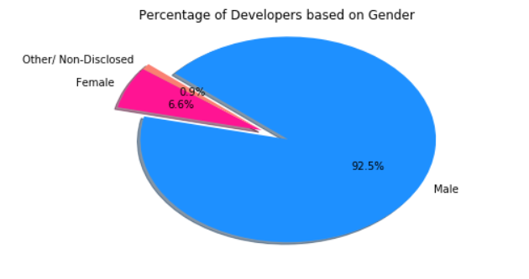
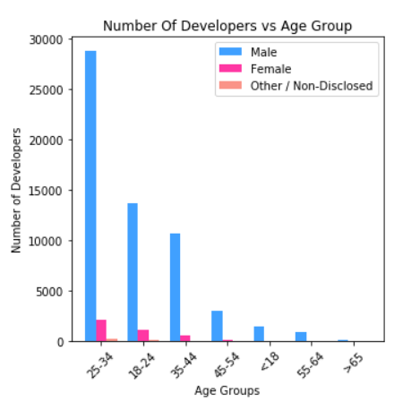
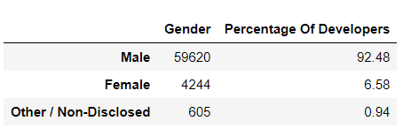
Gender & Age

Slide 8
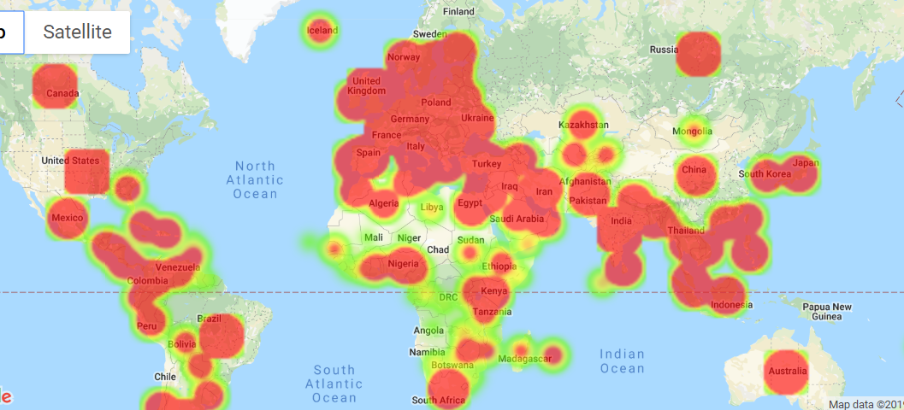
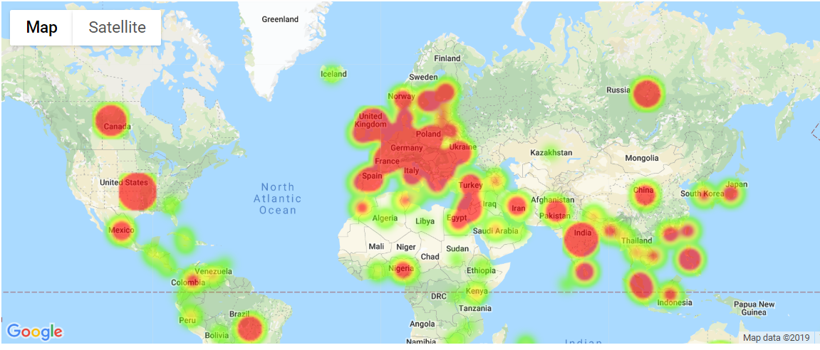
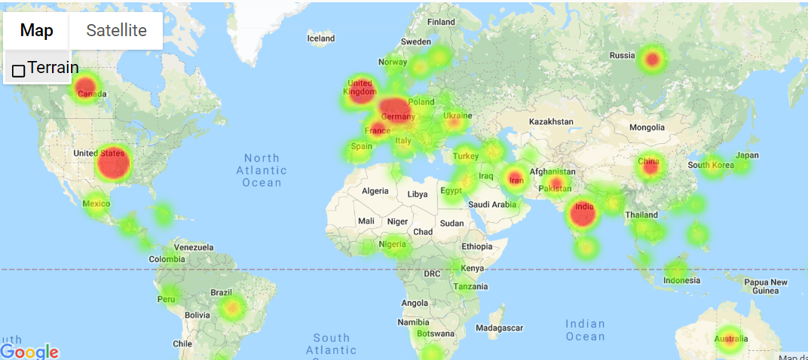
Female Developers
Male Developers
Other Developers
Country | Number Of Responders | Longitude | Latitude
United States | 15339 | -95.7129 | 37.0902
India | 6434 | 78.9629 | 20.5937
United Kingdom | 4549 | -3.43597 | 55.3781
Germany | 4404 | 10.4515 | 51.1657
Canada | 2423 | -106.347 | 56.1304

Slide 9
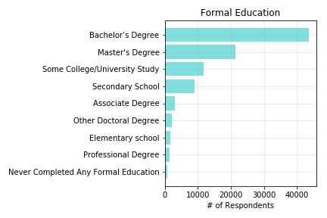
Formal Education
Labels | Values | % of Respondents
Bachelor’s Degree | 43659 | 46.10
Master's Degree | 21396 | 22.59
Some College/University Study | 11710 | 12.36
Secondary School | 8951 | 9.45
Associate Degree | 2970 | 3.14
Other Doctoral Degree | 2214 | 2.34
Elementary school | 1656 | 1.75
Professional Degree | 1447 | 1.53
Never Completed Any Formal Education | 700 | 0.7
Total Formal Education responses: 94703

Slide 10
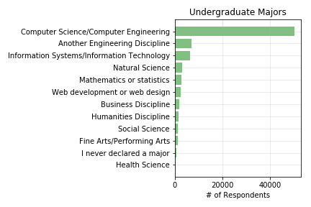
Undergraduate Majors
Labels | Values | % of Respondents
Computer Science/Computer Engineering | 50336 | 63.69
Another Engineering Discipline | 6945 | 8.79
Information Systems/Information Technology | 6507 | 8.23
Natural Science | 3050 | 3.86
Mathematics or statistics | 2818 | 3.57
Web development or web design | 2418 | 3.06
Business Discipline | 1921 | 2.43
Humanities Discipline | 1590 | 2.01
Social Science | 1377 | 1.74
Fine Arts/Performing Arts | 1135 | 1.44
I never declared a major | 693 | 0.88
Health Science | 246 | 0.31
Total Undergraduate Major responses: 79036

Slide 11
Additional Education
Labels | Values | Percentage
Taught yourself a new language, framework, or tool without taking a formal course | 58,891 | 28.53%
Taken an online course in programming or software development (e.g. a MOOC) | 33,032 | 16.00%
Contributed to open source software | 27,800 | 13.47%
Received on-the-job training in software development | 23,849 | 11.55%
Participated in a hackathon | 17,872 | 8.66%
Participated in online coding competitions (e.g. HackerRank, CodeChef, TopCoder) | 16,528 | 8.01%
Taken a part-time in-person course in programming or software development | 12,131 | 5.88%
Completed an industry certification program (e.g. MCPD) | 9,332 | 4.52%
Participated in a full-time developer training program or bootcamp | 6,987 | 3.38%

Slide 12
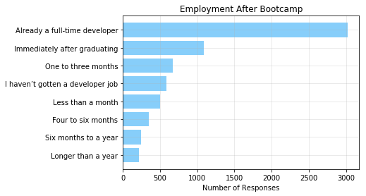
Employment After Bootcamp
Labels | Values | Percentage
Already a full-time developer | 3,025 | 45.48%
Immediately after graduating | 1,085 | 16.31%
One to three months | 668 | 10.04%
I haven’t gotten a developer job | 581 | 8.73%
Less than a month | 496 | 7.46%
Four to six months | 347 | 5.22%
Six months to a year | 239 | 3.59%
Longer than a year | 211 | 3.17%

Slide 13
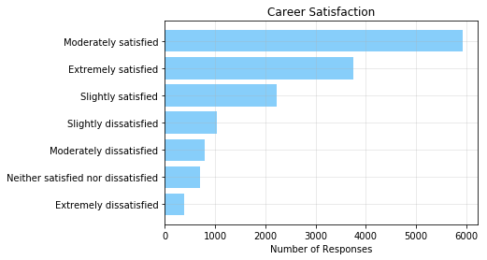
Career Satisfaction
Labels | Values | Percentage
Moderately satisfied | 5,933 | 39.96%
Extremely satisfied | 3,760 | 25.33%
Slightly satisfied | 2,228 | 15.01%
Slightly dissatisfied | 1,038 | 6.99%
Moderately dissatisfied | 788 | 5.31%
Neither satisfied nor dissatisfied | 705 | 4.75%
Extremely dissatisfied | 394 | 2.65%

Slide 14
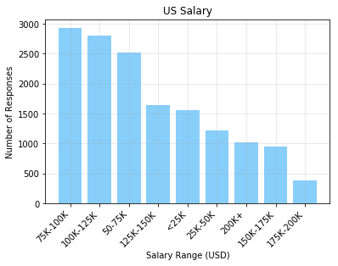
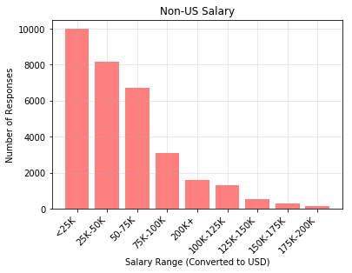
US vs. Non-US Salary
Average US Salary is: $95,780.86
Median US Salary is: $55,075.00
Average Non-US Converted Salary is: $76,534.60
Median Non-US Converted Salary is: $43,560.00

Slide 15
US vs. Non-US Salary T-Test
Salary | SalaryType | CurrencySymbol | ConvertedSalary
NaN | Monthly | KES | NaN
51000 | Yearly | GBP | 70841
NaN | NaN | NaN | NaN
NaN | NaN | NaN | NaN
260000 | Yearly | ZAR | 21426
30000 | NaN | GBP | 41671
120000 | Yearly | USD | 120000
NaN | NaN | NaN | NaN
250000 | Yearly | USD | 250000
NaN | NaN | NaN | NaN
T-stat is: -26.756215218863325
P-value is: 7.374040531539123e-155

Slide 16
T-Tests Results: Salary, Satisfaction, and Gender
US Bootcamp & US Salary:
F Stat. = 0.12016845999418452
P-Value = 0.7288567106403009
US Salary & US Career Satisfactions:
F Stat. = 50.259005007417045
P-Value = 9.055286781403873e-81
Gender & US Salary:
F Stat. = 2.510064082033512
P-Value = 0.08129913256618808
Gender & US Career Satisfaction:
F Stat. = 2.458735111052797
P-Value = 0.08557845414366759

